Slide 1

AquaTrail: IOT Based Smart Water Bottle
SRM INSTITUTE OF SCIENCE AND TECHNOLOGY
COLLEGE OF ENGINEERING AND TECHNOLOGY
18CSP107L / 18CSP108L- MINOR PROJECT / INTERNSHIP
Vinay Poddar(RA2011032010061)
Vanshaj Barnwal(RA2011032010035)
Batch ID:
Guide name and Designation:
Ms. Saisanthiya D, Assistant Professor

Slide 2
Table of contents
Project Title And Abstract
Problem Statement
Solution
Objectives
Literature Review
Architecture Diagram
Block Diagram
Modules
Output and Screenshot
Conclusion
References

Slide 3
Abstract
The smart water bottle will use a built-in sensor to measure the amount of water consumed and temperature of the water.
The sensor will be connected to a smartphone app that will display the user's water intake history and set daily water intake goals.
The app will also send reminders to the user to drink water when they are not meeting their goals.
User-friendly interface for easy monitoring and management of Smart Water Bottle.

Slide 4
Problem Statement
People often forget to drink enough water. A smart water bottle could help people stay hydrated by tracking their water intake.
It can be difficult to stay hydrated while on the go. A smart water bottle could connect to a smartphone app, allowing users to track their water intake and receive reminders even when they are away from home.
User interface should be friendly, otherwise it will be difficult to understand and use the smart water bottle.
Water temperature detection is an important factor for drinking water so ensuring the temperature of water is optimum for drinking.

Slide 5
Solution
Key features of Smart Water Bottle:
User-Friendly Interface: Easily monitor and manage Smart water bottle.
Tracking: People often forget to drink enough water. A smart water bottle could help people stay hydrated by tracking their water intake.
Timely Reminders: A smart water bottle could connect to a smartphone app, allowing users to track their water intake and receive reminders even when they are away from home.
Comfort & Taste: Some people may prefer to drink water that is at a certain temperature, such as room temperature or cold water. A smart water bottle with temperature check can help users ensure that the water is at the desired temperature before drinking it.
Data Security and Privacy: Robust encryption measures for safeguarding sensitive information.

Slide 6
Objectives
Volume Monitoring: The smart water bottle should accurately measure and record the amount of water consumed by the user throughout the day.
Notifications and Reminders: The smart water bottle should send timely reminders to the user's smartphone to drink water if they have not consumed enough within a certain time interval.
IoT Connectivity: The bottle should be able to connect to the internet or a smartphone via Bluetooth, Wi-Fi, or other suitable means to enable data transmission and synchronization.
Safety and Comfort: To develop a smart water bottle that can track the temperature of the water and send reminders to drink water at the optimal temperature.

Slide 7
Literature Review
Notifications
- The proposed model gives a solution for the notifications with a application notification whereas the traditional method is used to notify via. Email which is very difficult for the user to track.
Alert
- The old proposed method notify every two hours, where the new method gives the user choice to customize the notifications according tot their needs.

Slide 8
Literature Review
Connectivity
- The traditional method used SMTP protocol to provide the connectivity, whereas the modern method uses MQTT(Message Queuing Telemetry Transport) protocol which is publish-subscribe message transport protocol.
New Fetaures
- The modern method uses DHT11 temperature sensor which show the temperature of water inside the bottle. It provides a comfort to the user to know if water is drinkable or not.

Slide 9
Literature Review
“HydrationCheck : An IOT based smart water bottle”, by Rahulkrishnan Ravindran , Radhika Ravindran and Anjali T.
This paper focuses on a system that only provides the user with the statistics of their daily amount of water intake and daily average, but also nudges the user with reminders on drinking water every 2 hours. Thus, this product provides the user with a meticulous way of managing their water intake which one tends to forget.

Slide 10
Literature Review
“A Fuzzy Logic Based Internet of Things (IoT) for Smart Water Bottle” by Angga Edwin Wijanark, Maman Abdurohman and Maman Abdurohman.
This paper proposes a system that develops a model based on fuzzy algorithm. Smart water bottle system provides the user with the prediction of their daily amount of water intake. The results provided are also in accordance with the rules that have been made, namely low, medium and high. The fuzzy algorithm used in the IOT platform is less responsive or still has a long enough delay, and can display more accurate measurements.

Slide 11
Literature Review
“The Emerging Internet of Things Marketplace From an Industrial Perspective” by Charith Perera, Chi Harold Liu and Srimal Jayawardena.
This paper presented a survey of the IoT solutions in the emerging marketplace. This paper classified the solutions in the market broadly into five categories: smart wearable, smart home, smart city, smart environment, and smart enterprise. It also the IoT solutions that have been proposed, designed, developed, and brought to market by industrial organisations

Slide 12
Literature Review
“IoT based based Sustainable Water Management” by Sreekanth Narendran, Preeja Pradeep and Maneesha Vinodini Ramesh.
This paper developed a system that will reduce human intervention in water management which is adaptable in both the urban and rural scenarios incorporating the sustainability factor. It come up with a viable system that automates the functions as well as increases the sustenance of the source in the long run.

Slide 13
Literature Review
“Smart water level monitoring and management system using IoT” by Anagha Praveen, R.Radhika, Sidharth D, Sreehari Ambat and Anjali T.
This project uses an esp8266 module. There is an ultrasonic sensor, which helps us check the fluid level inside the tank and also alerts the user to switch on/off the motor based on the case conditions that are pre-set. The project’s main goal was not only to attain precise monitoring of water level but also to maintain safety control in the process of it

Slide 14
Literature Review
“Hydration Reminding Smart Bottle: IoT Experimentation” By
Dr..P.B.Pankajavalli, Mr.R.Saikumar and Mr.R.Maheswaran.
This paper proposed a model of smart bottle architecture for hydration reminder to remind the humans to intake the sufficient water on time to keep the body stable is successfully implemented.
The project not only measures how much amount of water the user is drinking, but also indicates when it's time to top up by sending a messages to the smart phone.

Slide 15
Literature Review
“A Case Study of the Smart Water Bottle” by Emil Jovanov, Vindhya R Nallathimmareddygari and Jonathan E. Pryor.
In this article there are two implementations of the smart water bottle. Each approach has advantages for specific applications. Integration using a personal body area network is more power efficient, but requires personal gateway (smartphone) in the vicinity of the device, at least periodically throughout the day. A cloud based solution allows seamless integration for a large number of users using a standard infrastructure, but requires higher power consumption and significantly decreases battery life of the system.

Slide 16
Literature Review
“A Smart Water Bottle for New Seniors: Internet of Things (IOT) and Health Care Services” by Nam Eui Lee, Tae Hwa Lee, Dong Heui Seo and Sung Yeon Kim.
This paper proposes a design which is very encouraging. It is aimed at developing a highly efficacious and practical water intake management planner that provides both diagnosis and prescription based on user water intake rather than simply providing suggestions and confirming ingestion. Therefore, if this solution is introduced, enabling users to develop and manage proper water intake habits, it will receive attention from members of the new senior generation who are interested in health. It will also open a new chapter in research on water intake.

Slide 17
Literature Review
“Using an Arduino and a smartwatch to measure liquid consumed fro any container” by Sonia Soubam, Manisha Agrawal and Vinayak Naik.
This paper presented an automated liquid intake tracking solution, which does not require recurrent input from user. It uses accelerometer data from a smartwatch to detect drinking gesture of user and a load sensor-equipped container to determine the amount of liquid consumed in each sip.

Slide 18
Literature Review
“Towards wearable sensing-based assessment of fluid intake” by Oliver Amft, David Bannach, Gerald Pirkl, Matthias Kreil and Paul Lukowicz.
This paper proposes a design and implements a fluid intake monitoring system that fulfills many requirements for fluid intake monitoring: it is based on an easily deployable, simple sensor setup, works across different drinking containers, and has the ability to provide information on container type and fluid level.

Slide 19
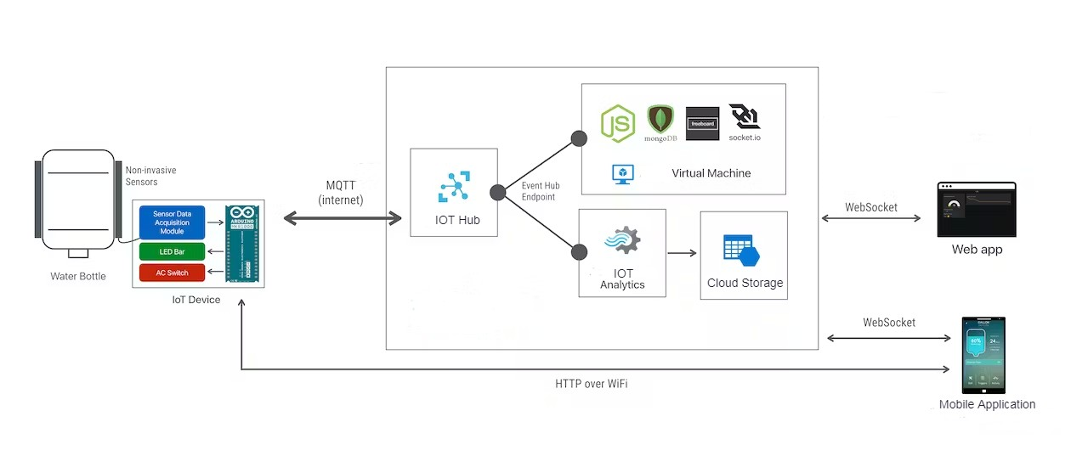
Architecture Diagram

Slide 20
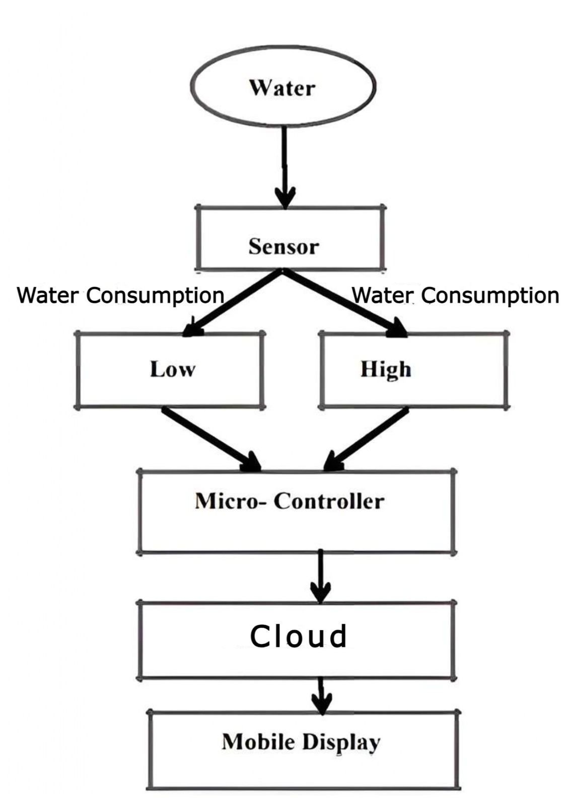
Block Diagram

Slide 21
Modules
Input – This stage involves Arduino, sensors(hc-sr04) which captures the data. The data collection can be done using microprocessor(NodeMCU) which can be sent for processing capablilities.
Processing – After data collection, the data needs to be sent to the cloud(using Wifi-Module) over the MQTT protocol using publish and subscribe messaging transport. The message is sent to the output after data processing is done.
Output – The actions which are need to be performed after data processing is to be displayed on the output device via. Mobile application.

Slide 22
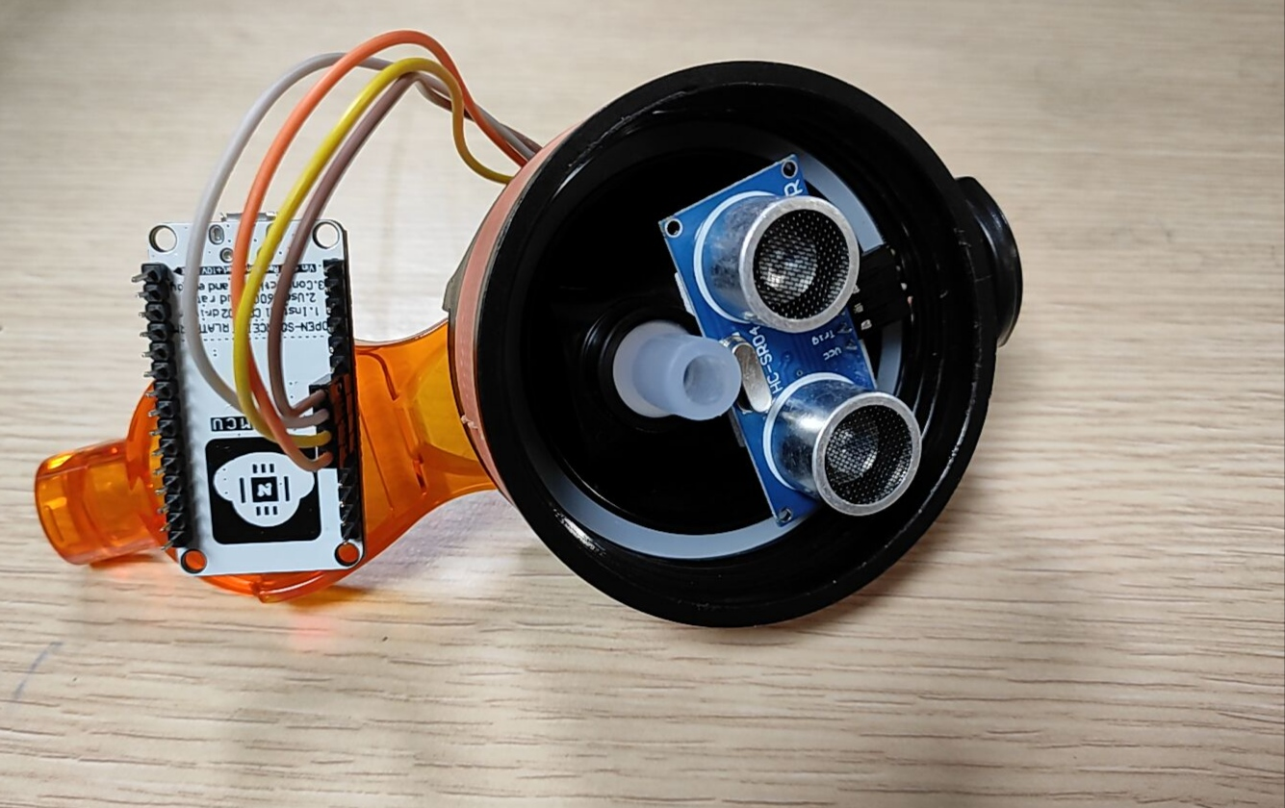
Output and ScreenShot

Slide 23
Conclusion
In conclusion, the AquaTrail project represents a significant step forward in the intersection of technology and health.
Through this project, we have successfully designed, developed, and tested a smart water bottle that not only helps individuals stay hydrated but also promotes healthier lifestyles.
AquaTrail incorporates a range of features, including hydration tracking, personalized reminders, and compatibility with mobile applications, which provide users with the tools they need to make better choices when it comes to their daily water intake.
Our project has highlighted the potential for technology to enhance our well-being and encourage healthier habits in a world where staying hydrated can be challenging.

Slide 24
REFERENCES
Ravindran, Rahulkrishnan, Radhika Ravindran, and T. Anjali. "HydrationCheck: An IOT based smart water bottle." 2022 13th International Conference on Computing Communication and Networking Technologies (ICCCNT). IEEE, 2022.
Perera, Charith, Chi Harold Liu, and Srimal Jayawardena. "The emerging internet of things marketplace from an industrial perspective: A survey." IEEE transactions on emerging topics in computing 3.4 (2015): 585-598.
Soubam, Sonia, Manisha Agrawal, and Vinayak Naik. "Using an Arduino and a smartwatch to measure liquid consumed from any container." 2017 9th International Conference on Communication Systems and Networks (COMSNETS). IEEE, 2017.
Narendran, Sreekanth, Preeja Pradeep, and Maneesha Vinodini Ramesh. "An Internet of Things (IoT) based sustainable water management." 2017 IEEE global humanitarian technology conference (GHTC). IEEE, 2017.
Cohen, Rachel, Geoff Fernie, and Atena Roshan Fekr. "Monitoring fluid intake by commercially available smart water bottles." Scientific Reports 12.1 (2022): 4402.
Podder, Chandan, and Kevin Sritharan. Early Market Entry Strategies for Commercialization of Digital Innovation in the Welfare Sector: A Case of Smart Nutritional Bottle “FitPot”. MS thesis. uis, 2023.

Slide 25
Thank You

